Slide 1

TRIGONOMETRY
Math 12
Plane and Spherical Trigonometry

Slide 2
TRIGONOMETRY
Derived from the Greek words “trigonon” which means triangle and “metron” which means to measure.
Branch of mathematics which deals with measurement of triangles (i.e., their sides and angles), or more specifically, with the indirect measurement of line segments and angles.

Slide 3
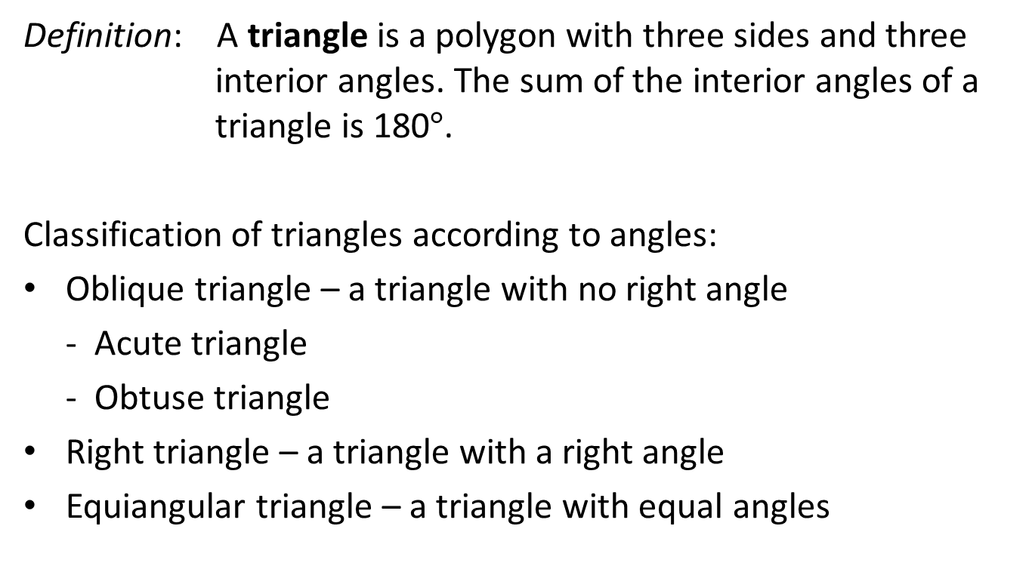
TRIANGLES
Definition: A triangle is a polygon with three sides and three interior angles. The sum of the interior angles of a triangle is 180$°$.
Classification of triangles according to angles:
Oblique triangle – a triangle with no right angle
- Acute triangle
- Obtuse triangle
Right triangle – a triangle with a right angle
Equiangular triangle – a triangle with equal angles

Slide 4
TRIANGLES
Classification of triangles according to sides:
Scalene Triangle - a triangle with no two sides equal.
Isosceles Triangle - a triangle with two sides equal.
Equilateral triangle – a triangle with three sides equal.

Slide 5
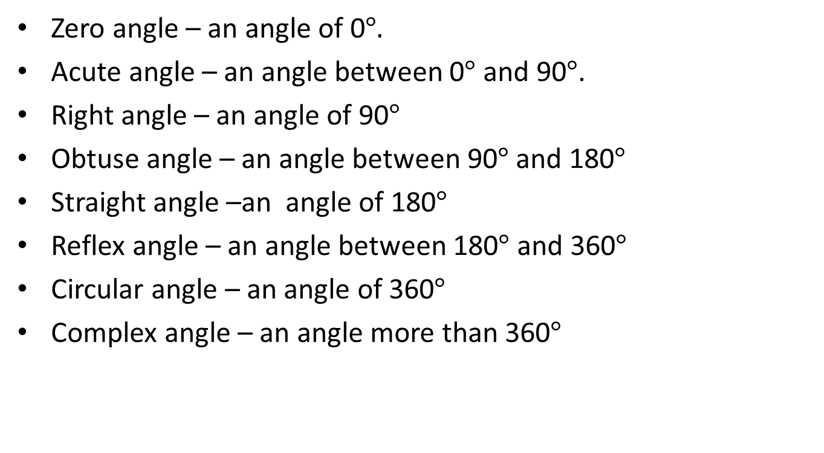
CLASSIFICATION OF ANGLES
Zero angle – an angle of 0$°.$
Acute angle – an angle between 0$°$ and 90$°$.
Right angle – an angle of 90$°$
Obtuse angle – an angle between 90$°$ and 180$°$
Straight angle –an angle of 180$°$
Reflex angle – an angle between 180$°$ and 360$°$
Circular angle – an angle of 360$°$
Complex angle – an angle more than 360$°$

Slide 6
Lesson 1: ANGLE MEASURE
Math 12
Plane and Spherical Trigonometry
Notes:
Week 1

Slide 7
OBJECTIVES
At the end of the lesson the students are expected to:
Measure angles in degrees and radians
Define angles in standard position
Convert degree measure to radian measure and vice versa
Find the measures of coterminal angles
Calculate the length of an arc along a circle.
Solve problems involving arc length, angular velocity and linear velocity

Slide 8
ANGLE
An angle is formed by rotating a ray about its vertex from the initial side to the terminal side.
An angle is said to be in standard position if its initial side is along the positive x-axis and its vertex is at the origin.
Rotation in counterclockwise direction corresponds to a positive angle.
Rotation in clockwise direction corresponds to a negative angle.

Slide 9
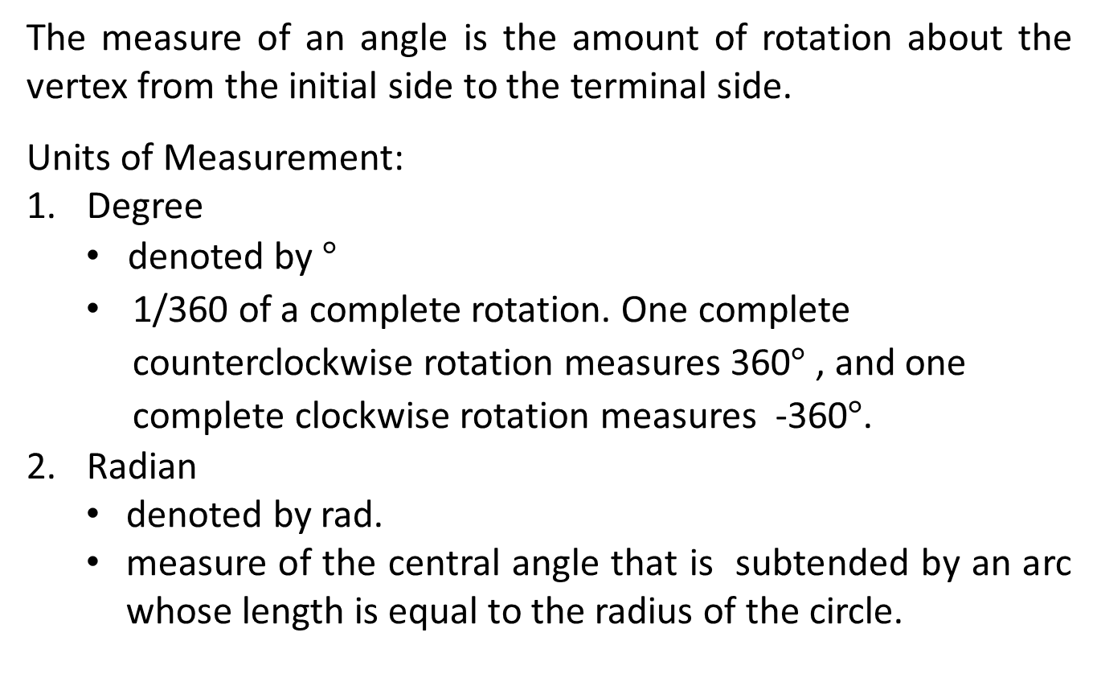
ANGLE MEASURE
The measure of an angle is the amount of rotation about the vertex from the initial side to the terminal side.
Units of Measurement:
Degree
denoted by $°$
1/360 of a complete rotation. One complete counterclockwise rotation measures 360$°$ , and one complete clockwise rotation measures -360$°$.
Radian
denoted by rad.
measure of the central angle that is subtended by an arc whose length is equal to the radius of the circle.

Slide 10

Definition: If a central angle $θ$ in a circle with radius r intercepts an arc on the circle of length s, then
$θ \left(in radians\right)=\frac{s}{r}$
$θ_{full rotation}≈2π≈360°$
$$π≈180°$$

Slide 11
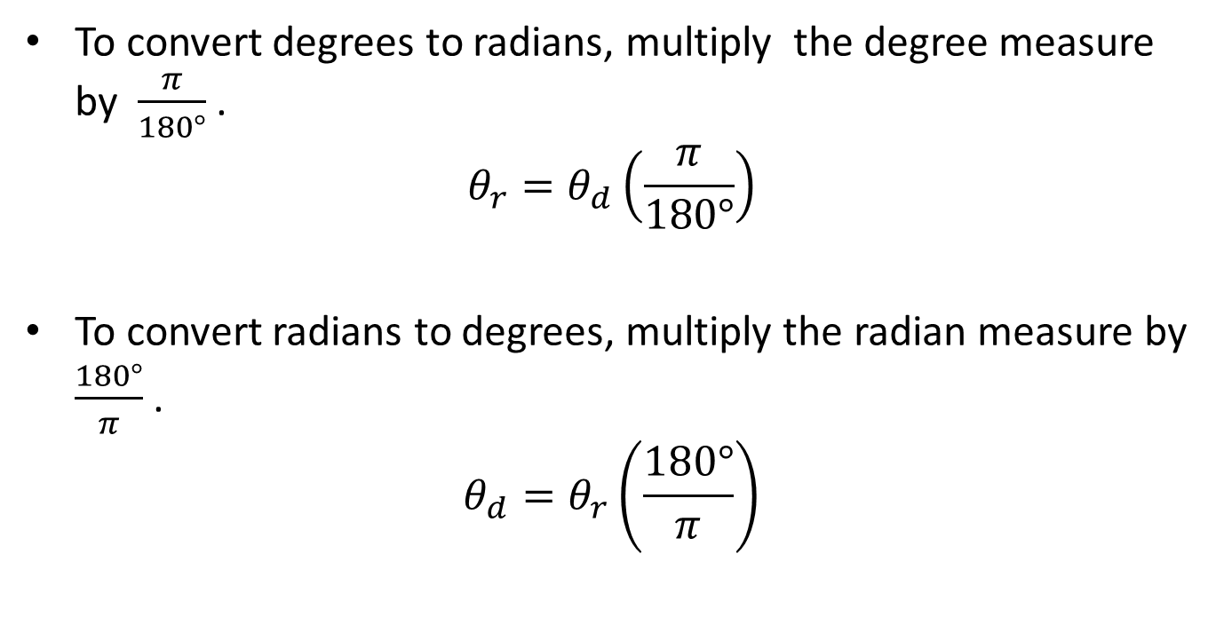
CONVERTING BETWEEN DEGREES and RADIANS
To convert degrees to radians, multiply the degree measure by $\frac{π}{180°}$.
$$θ_{r}=θ_{d}\left(\frac{π}{180°}\right)$$
To convert radians to degrees, multiply the radian measure by $\frac{180°}{π}$ .
$$θ_{d}=θ_{r}\left(\frac{180°}{π}\right)$$

Slide 12
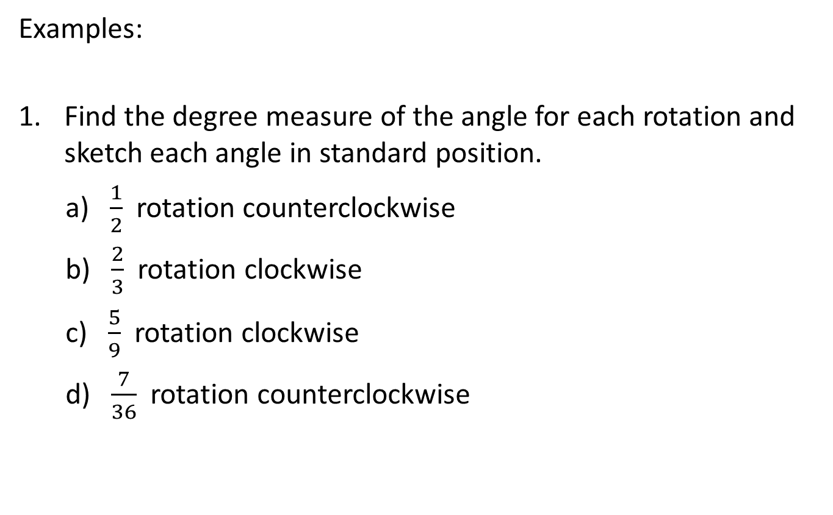
Examples:
Find the degree measure of the angle for each rotation and sketch each angle in standard position.
a) $\frac{1}{2}$ rotation counterclockwise
b) $\frac{2}{3}$ rotation clockwise
c) $\frac{5}{9}$ rotation clockwise
d) $\frac{7}{36}$ rotation counterclockwise

Slide 13
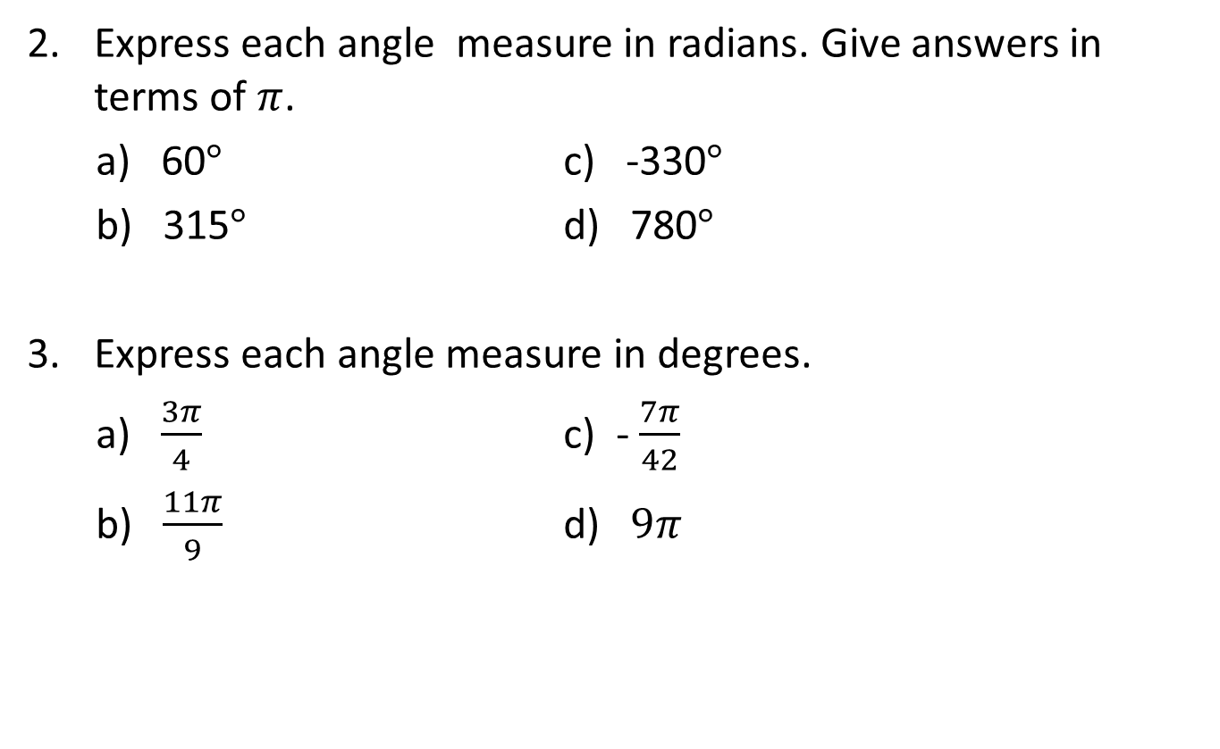
Express each angle measure in radians. Give answers in terms of $π$.
a) 60$°$ c) -330$°$
b) 315$°$ d) 780$°$
Express each angle measure in degrees.
a) $\frac{3π}{4}$ c) - $\frac{7π}{42}$
b) $\frac{11π}{9}$ d) $9π$

Slide 14
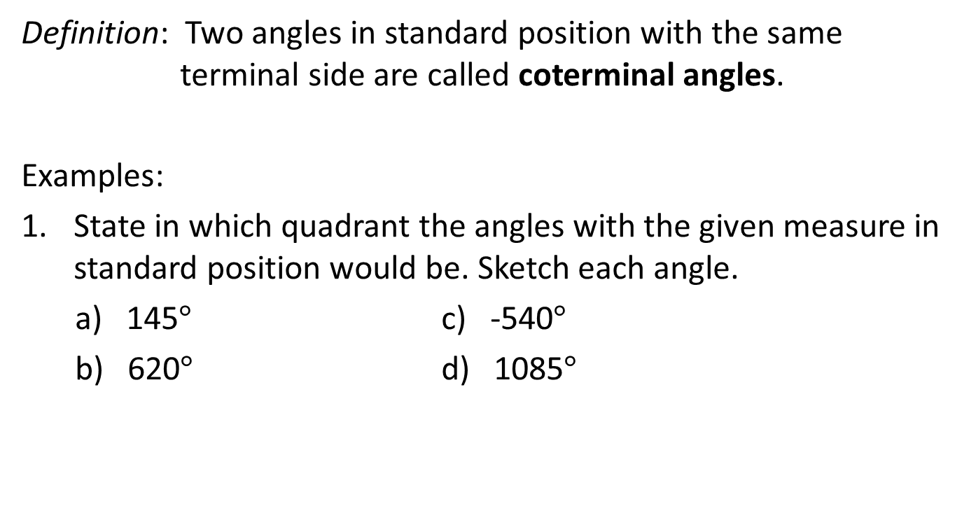
COTERMINAL ANGLES
Definition: Two angles in standard position with the same terminal side are called coterminal angles.
Examples:
State in which quadrant the angles with the given measure in standard position would be. Sketch each angle.
a) 145$°$ c) -540$°$
b) 620$°$ d) 1085$°$

Slide 15

COTERMINAL ANGLES
Determine the angle of the smallest possible positive measure that is coterminal with each of the given angles.
a) $405°$ c) 9$60°$
b) -1$35°$ d) 1350$°$

Slide 16

LENGTH OF A CIRCULAR ARC
Definition: If a central angle $θ$ in a circle with radius r intercepts an arc on the circle of length s, then the arc length s is given by
$s=rθ$ $θ$ is in radians
r
S

Slide 17
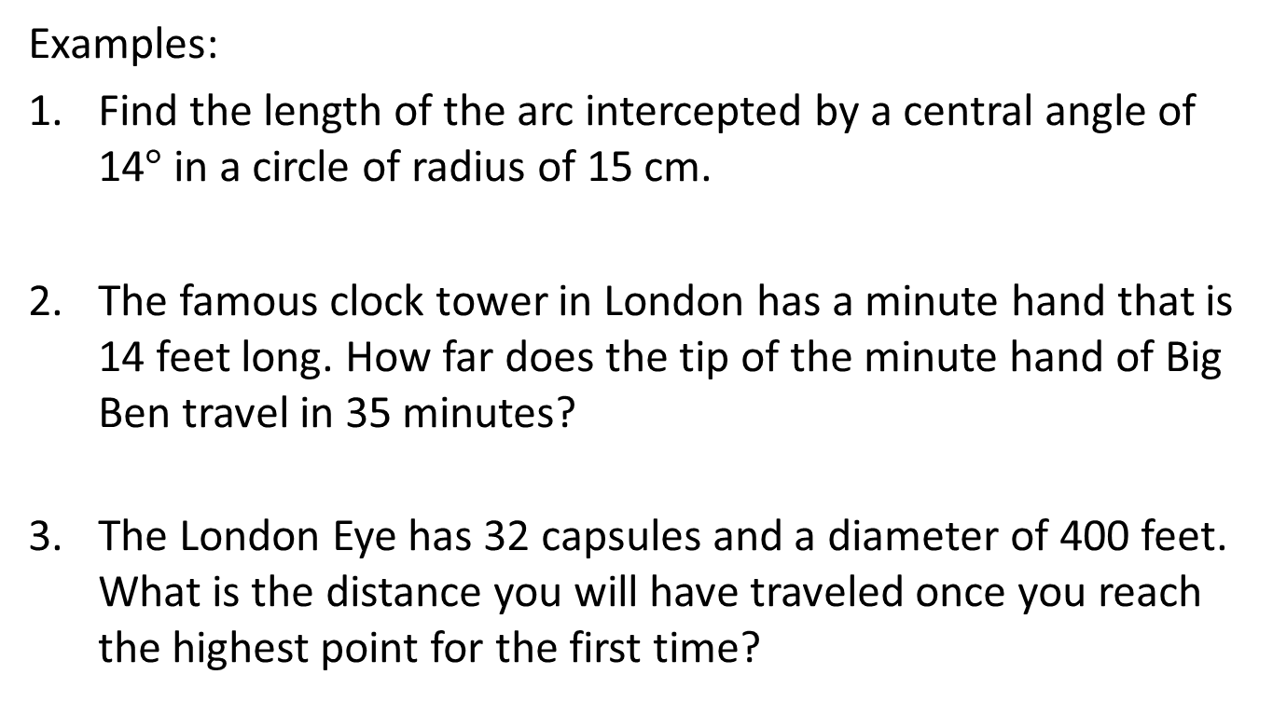
LENGTH OF A CIRCULAR ARC
Examples:
Find the length of the arc intercepted by a central angle of 14$°$ in a circle of radius of 15 cm.
The famous clock tower in London has a minute hand that is 14 feet long. How far does the tip of the minute hand of Big Ben travel in 35 minutes?
The London Eye has 32 capsules and a diameter of 400 feet. What is the distance you will have traveled once you reach the highest point for the first time?

Slide 18
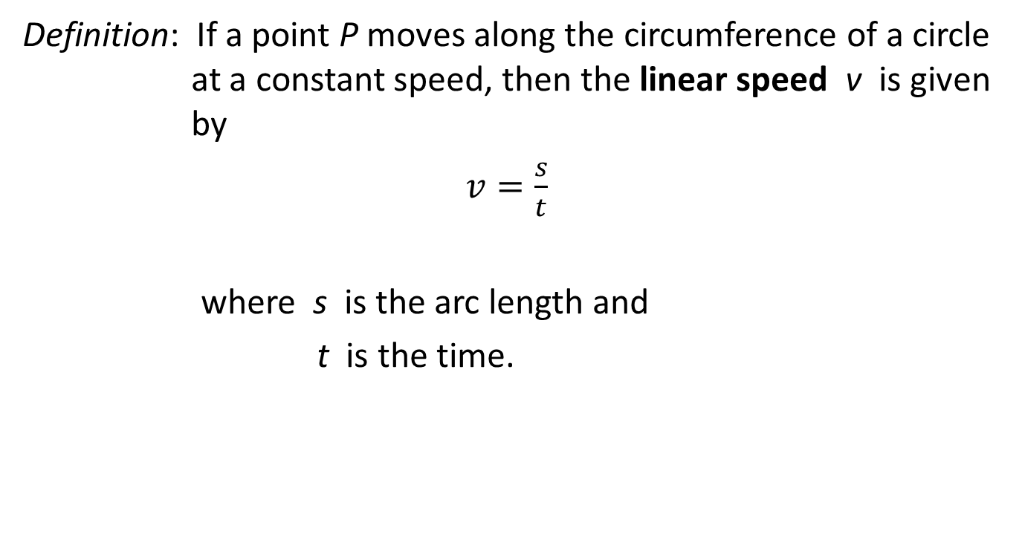
LINEAR SPEED
Definition: If a point P moves along the circumference of a circle at a constant speed, then the linear speed v is given by
$v=\frac{s}{t}$
where s is the arc length and
t is the time.

Slide 19
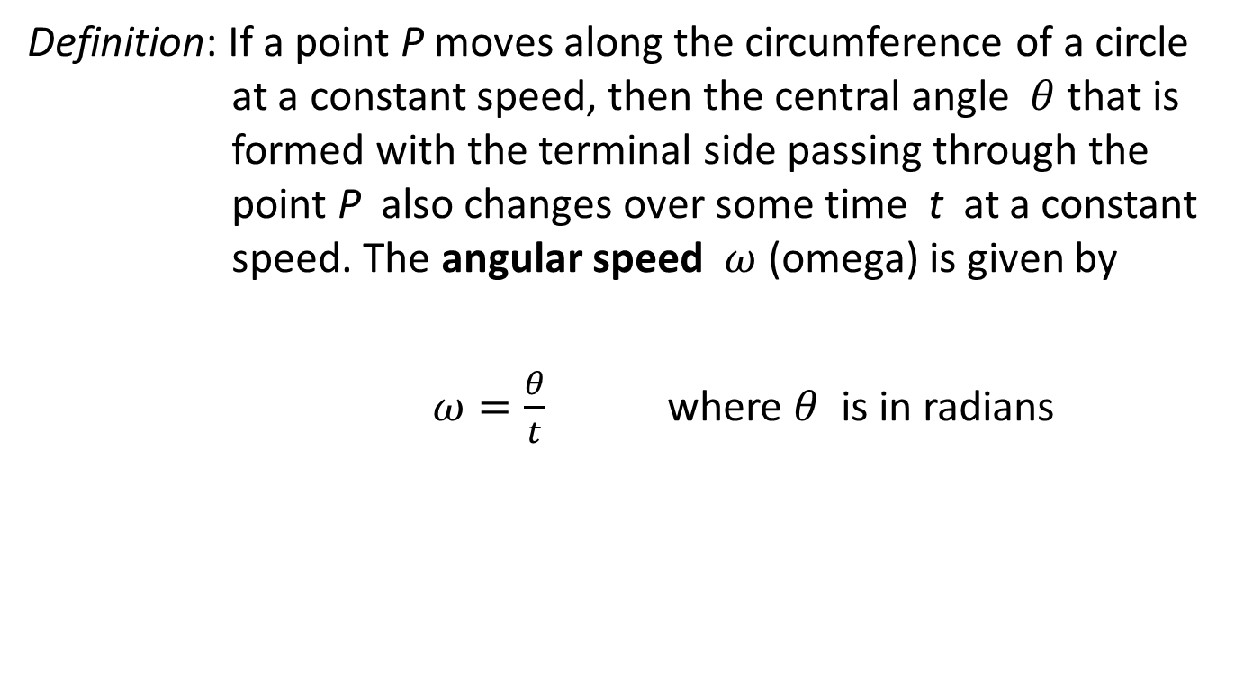
ANGULAR SPEED
Definition: If a point P moves along the circumference of a circle at a constant speed, then the central angle $θ$ that is formed with the terminal side passing through the point P also changes over some time t at a constant speed. The angular speed $ω$ (omega) is given by
$ω=\frac{θ}{t}$ where $θ$ is in radians

Slide 20
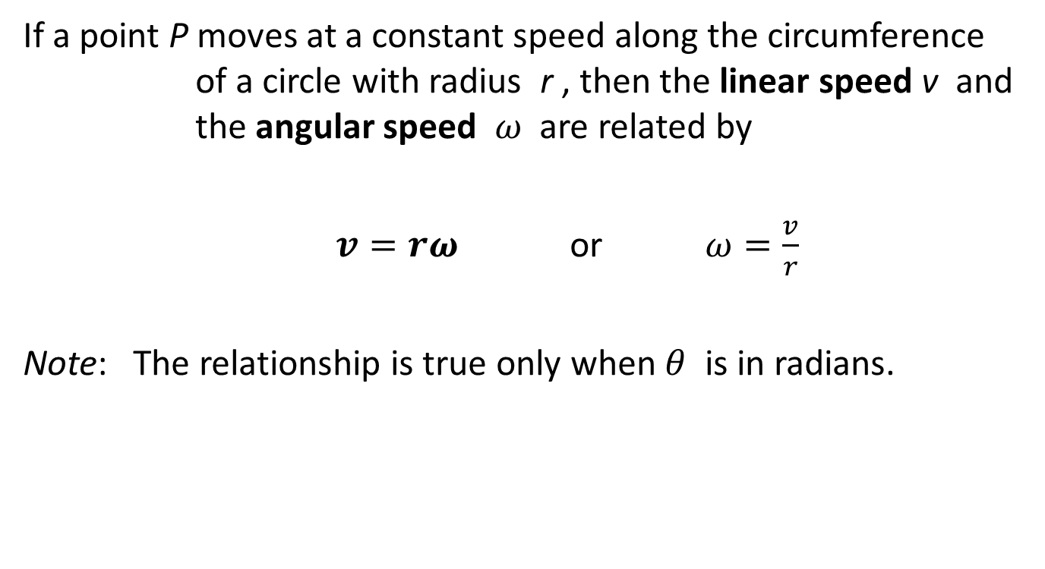
RELATIONSHIP BETWEEN LINEAR and ANGULAR SPEEDS
If a point P moves at a constant speed along the circumference of a circle with radius r , then the linear speed v and the angular speed $ω$ are related by
$v=rω$ or $ω=\frac{v}{r}$
Note: The relationship is true only when $θ$ is in radians.

Slide 21
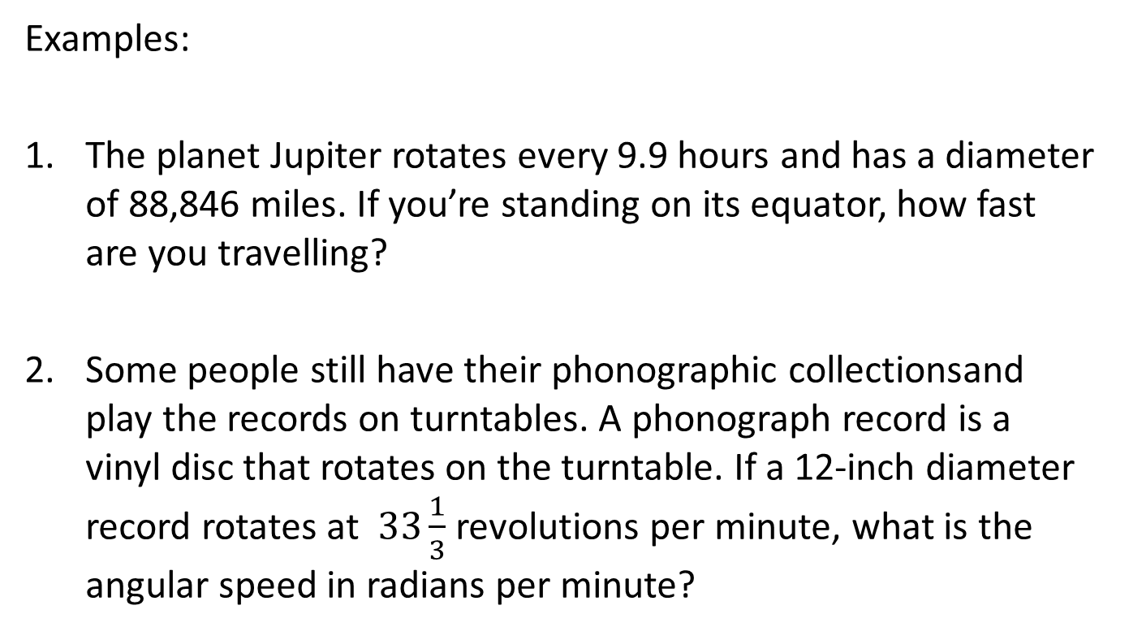
LINEAR and ANGULAR SPEED
Examples:
The planet Jupiter rotates every 9.9 hours and has a diameter of 88,846 miles. If you’re standing on its equator, how fast are you travelling?
Some people still have their phonographic collectionsand play the records on turntables. A phonograph record is a vinyl disc that rotates on the turntable. If a 12-inch diameter record rotates at $33\frac{1}{3}$ revolutions per minute, what is the angular speed in radians per minute?

Slide 22
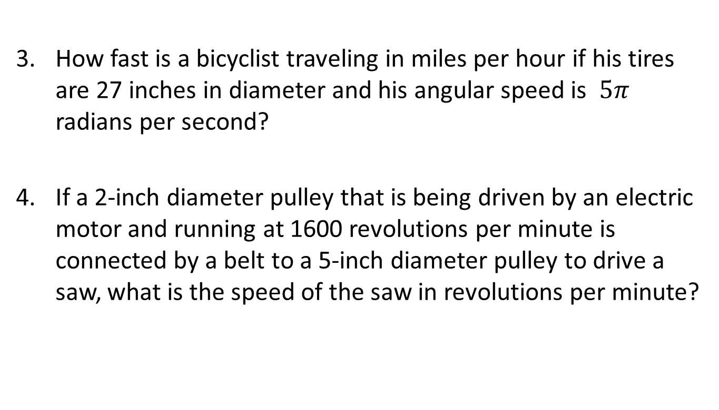
LINEAR and ANGULAR SPEED
How fast is a bicyclist traveling in miles per hour if his tires are 27 inches in diameter and his angular speed is $5π$ radians per second?
If a 2-inch diameter pulley that is being driven by an electric motor and running at 1600 revolutions per minute is connected by a belt to a 5-inch diameter pulley to drive a saw, what is the speed of the saw in revolutions per minute?

Slide 23
LINEAR and ANGULAR SPEED
Two pulleys, one 6 in. and the other 2 ft. in diameter, are connected by a belt. The larger pulley revolves at the rate of 60 rpm. Find the linear velocity in ft/min and calculate the angular velocity of the smaller pulley in rad/min.
The earth rotates about its axis once every 23 hrs 56 mins 4 secs, and the radius of the earth is 3960 mi. Find the linear speed of a point on the equator in mi/hr.

Slide 24
REFERENCES
Algebra and Trigonometry by Cynthia Young
Trigonometry by Jerome Hayden and Bettye Hall

